Slide 1
Neural Network Model for the Sales of a Butcher Shop
Tucker Lebor

Slide 2
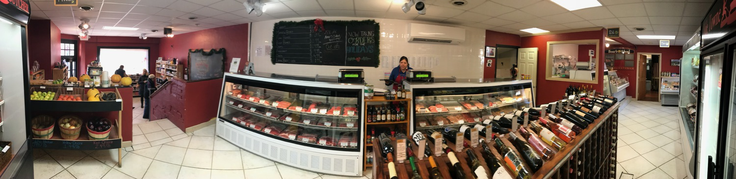
Olde Towne Butcher
A butcher shop in Fredericksburg, VA.
Sells various high-end organic goods and produce.
Highly anomalous sales, especially around holidays.

Slide 3
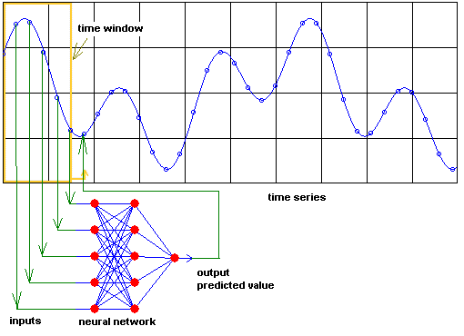
Time series neural network
A neural network is a series of neurons, which communicate to each other by layer and pass values along to a set of output neurons.
Weights alter the information as it passes allowing prioritization and pattern recognition.
Time series problems predict the next data point based on the past n data points.
https://rahmadya.com/2015/10/19/prediksi-dengan-jaringan-syaraf-tiruan/

Slide 4
Time series neural network
Neural networks can be used to recognize faint or unusual patterns that may lead to anomalies in sales.
No user input or identification is needed to develop these patterns.

Slide 5
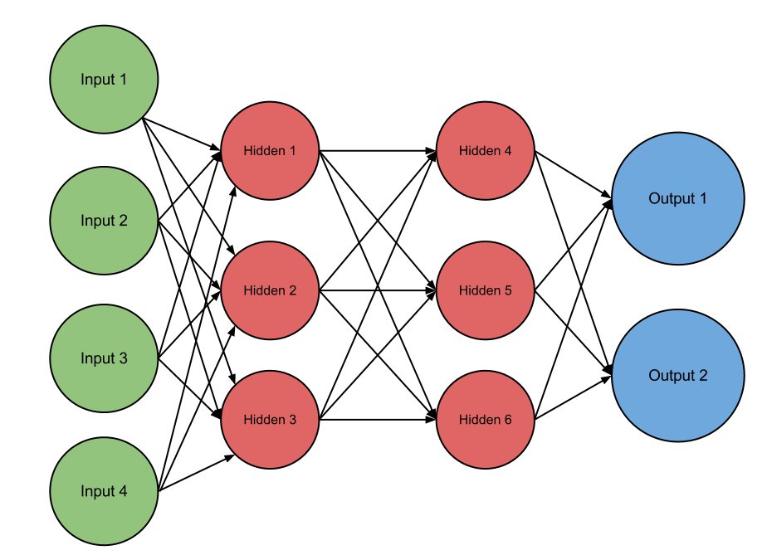
http://andrew.gibiansky.com/blog/machine-learning/machine-learning-neural-networks/
Sales of day t-1 in category 1
Sales of day t-2 in category 1
Sales of day t-1 in category 2
Sales of day t-2 in category 2
Prediction of day t sales in category 1
Prediction of day t sales in category 2

Slide 6
Comparison to previous research
The resulting model will be a combination of a time-series prediction and a correlation / recommendation system.
Studies have been done on both sales prediction (Penpece & Elma, 2014), and product correlation (Sano, Machino, Yada, & Suzuki, 2015).
However, few have done both simultaneously.

Slide 7
Pre-Processing
Many of the products were not categorized, ranging from $16,000 to $45 per month
Many products are not easily classified, or in small volume (eg. Lamb), they were ignored
Some unusual patterns may have to be ignored, such as sudden, unrecovered sales drops and whatever happened on 1/13/2016
The original categories had to be checked and combined to form the desired categories (eg. Local Beef=Meat)
Some products changed categories partway through the data

Slide 8
Total Sales
Models for the daily total revenue were run
The best of which was a network of 10 neurons per layer and 7 delays
Moderate overfitting, extrapolation visibly less accurate than interpolating
The pattern of the actual data was not very consistent, so I switched to categorized sales

Slide 9
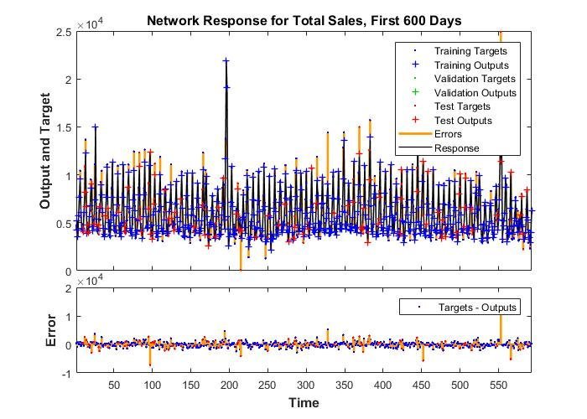
Total Sales
R value of first 600, test points only: 0.7492
R value of last 206: 0.6314
Bayesian Regularization

Slide 10
Categorized Sales
Started with mid-sized categories: Bakery, Beef, Dairy, Deli, Grocery, Pork, Poultry, Produce, Sausage, Seafood, Alcohol
Massive overfitting, delays reduced to 2
Very little correlation to data when extrapolating
Simpler categories used: Alcohol, Dairy, Deli, Grocery, Meat, Produce

Slide 11
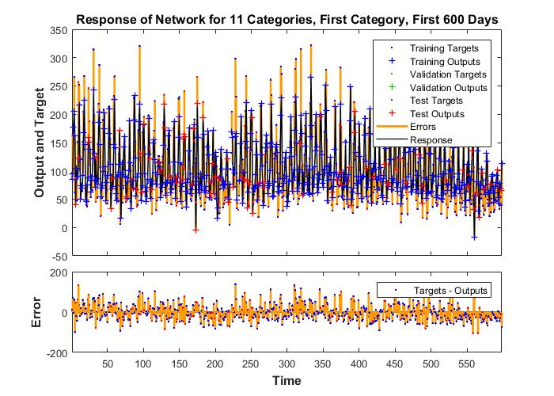
Categorized Sales, 11 Categories
R value of first 600 days (all categories, test points only): 0.891
R value of last 206 days (all categories): 0.361
Bayesian Regularization

Slide 12
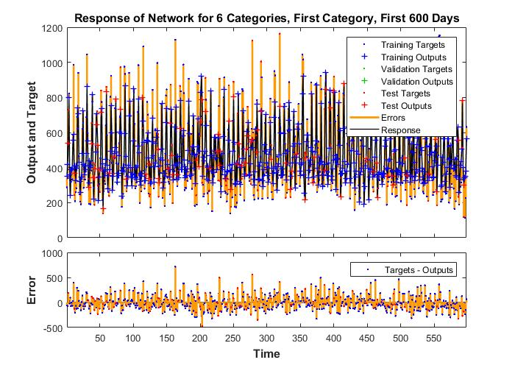
Categorized Sales, 6 Categories
R value of first 600 days (all categories, test points only): 0.885
R value of last 206 days (all categories): 0.446
Bayesian Regularization

Slide 13
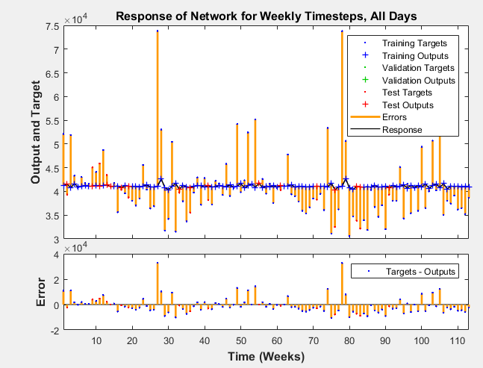
One Week Timesteps
Every 7 timesteps were collapsed into one to create weekly timesteps instead of daily.

Slide 14
Weekly Moving Sum of Total Sales
Interpolation accuracy of the network is much better, as is testing on the last 200 data points.
Actual data was more consistent, as was the model, though MSE becomes colluded due to massive, infrequent errors
Testing the last 200 data points with a closed loop network produced extreme error

Slide 15
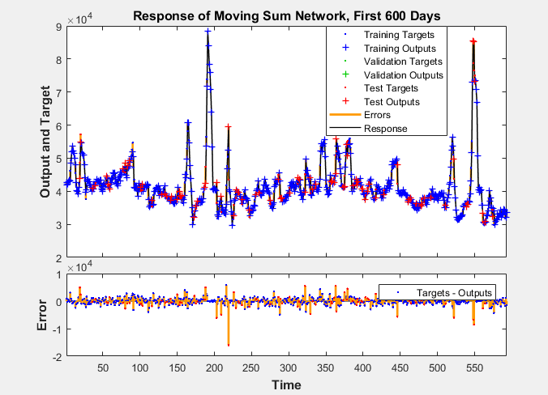
Weekly Moving Sum of Total Sales
R value of test points within first 600 days: 0.943
R value of last 200 days: 0.929

Slide 16
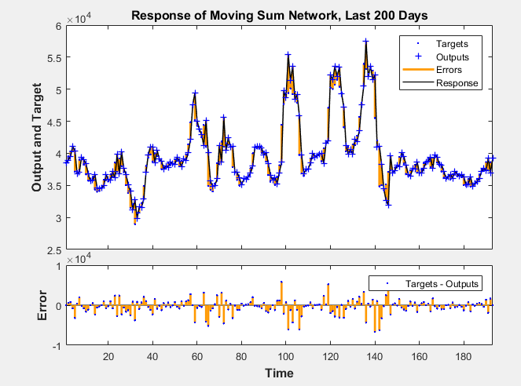
Weekly Moving Sum of Total Sales

Slide 17
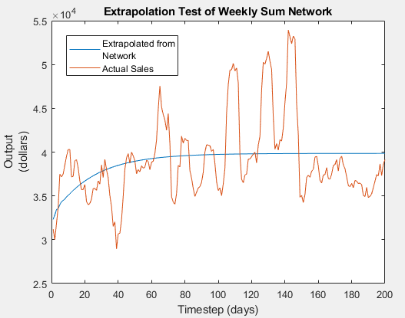
Extrapolation Testing
Done with a closed loop network, which is a network that uses its own outputs as inputs for the next time step.
This allows the network to predict more than one time step ahead, though with increasing error.

Slide 18
To Do
Import data from the last 4 months
Fix extrapolation code, or optimize network based on extrapolation performance
Compare extrapolations to order histories to determine the practicality of the network

Slide 19
Bibliography
Penpece, D., Elma, O. E. (2014). Predicting sales
revenue by using artificial neural network in
grocery retailing industry: a case study in
Turkey. International Journal of Trade,
Economics and Finance, 5, 435-439.
Sano, N., Machino, N., Yada, K., & Suzuki, T. (2015).
Recommendation system for grocery store
considering data sparsity. Procedia Computer
Science, 60, 1406-1413.

